Slide 1

WORKING DESCRIPTION
OCTOBER, 2017
TD2 team - STS2 group
Renesas design vietnam

Slide 2
Agenda
Team introduction Page 03
e2 studio introduction Page ??
Project team members Page ??
Working flow Page ??
SCRUM Page ??

Slide 3

TEAM introduction

Slide 4
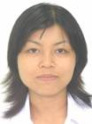









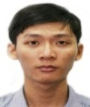








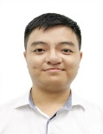
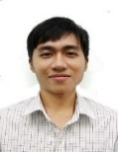

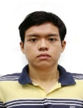
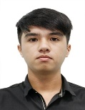
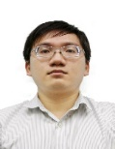
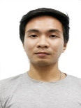
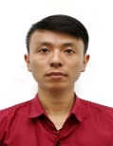
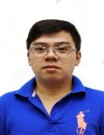




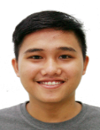
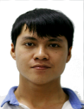

Software Tool Solution 2 Group (2017/10/01)
Group information
Member: 32
Extension: 4019
Location: 4th floor (east)
Group Leader
Vi Thai
Tool Development 2
Tool Development 3
Tool Development 4
ASE
Team Leader
Team Leader
Van Tran
Ninh Huynh
Thang Ph.
Debugger plugin
Smart Utility
CG & PinView
Smart Configurator
RTOS Tool
RTOS Kernel
S
S
S
S
Vinh Luong
Hien Dinh
Hai Ng.
Tra Ng.
Kinh Ng.
S
S
Hoang Ng.
Nam Ng.
Phuong Ng.
Phong H.
Hoa Dang
Minh Tran
Vu Pham
Quan Le
Quyet Trinh
Hieu Tran
Nguyen D.
Chinh Ng.
Manh Le
Vien Ng.
Khoa Vo
Thanh Pham
Hoai Tran
Duy Ng.
Truc Le
Huy Pho
Đuc Tran
Dung Ly
Dat Phan
Dung Tran
Triet Pham
S
Senior Engineer
ASE
- Associate Staff Engineer

Slide 5
e2 studio introduction

Slide 6
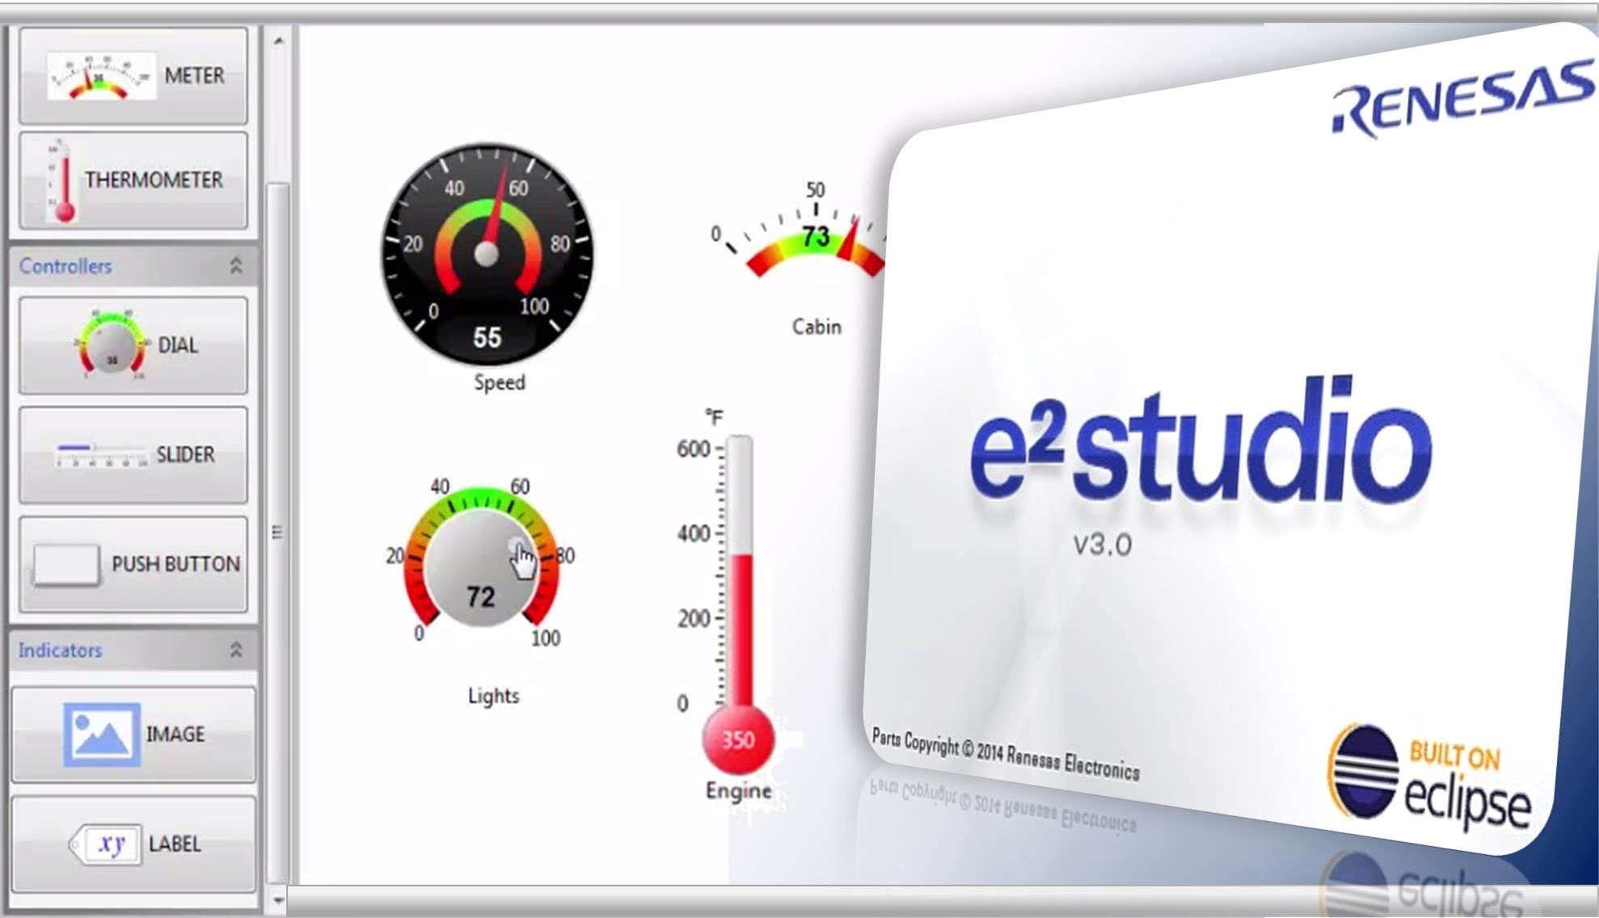
E2 studio introduction
Renesas e² studio is a development environment based on the popular Eclipse CDT, covers build (editor, compiler and linker control) as well as debug interface.
A wide range of compilers can be integrated into e² studio. Combined with the extremely powerful editor functionality and project management tools of Eclipse CDT, e² studio offers a state of the art coding environment for Renesas embedded controllers.

Slide 7
e2 studio device supported
Key to the flexibility of e² studio is the integration of on-chip debuggers and in-circuit emulators.
Target Device | Renesas E2 emulator | Renesas E1/E20 emulator ^{(Note1)} | Renesas E2 emulator Lite | Renesas IECUBE | Renesas E10A-USB | Segger J-Link
RL78 | Yes | Yes | Yes | Yes | No | No
RX100 | No | Yes | Yes | No | No | No ^{(Note2)}
RX200 | No | Yes | Yes | No | No | Yes
RX600 | No | Yes | Yes | No | No | Yes
RX700 | No | Yes | Yes | No | No | No
RH850 | No | Yes | No | No | No | No
RZ | No | No | No | No | No | Yes
Renesas Synergy™ | No | No | No | No | No | Yes
SH-2/SH-2A | No | No | No | No | Yes | No
Notes:
E20 feature is available with specific RX Family devices. E1 compatible features are available for other devices.
Segger debugger support is currently in development.

Slide 8
Project Team Members

Slide 9
Project Team Members
Vi Thai (PM/Project Owner)
Van Tran (PL/Scrum Master)
Vinh Luong (Will go for LTT on Oct) (Waveform, Coverage, Visual Expression, GDB Server)
Nam Nguyen (Trace, Stack Analysis, Load Module Converter, Smart Browser, Profile, Performance Analysis)
Hien Dinh (Smart manual, Smart Application Note)
Hoang Nguyen (IO register view, Misra-C, monitor point in Current Consumption, Eventpoints)
Phuong Nguyen (Real-time chart, OA, GDB Server, Debug Console, part of ADM, Current Consumption)

Slide 10
Project Team Members
Chinh Nguyen (Image Rendering, Memory Usage)
Manh Le (assigned ticket by other members)
Nguyen Duong (assigned ticket by other members)
Hieu Tran (assigned ticket by other members)
Vien Nguyen (Trainee - assigned ticket by other members)
Visual Expression: Will consider to assign member

Slide 11
WORKING FLOW

Slide 12
WORKING FLOW
Investigate
Important step to understand the issue of the ticket. Deciding which bugs to work on is not easy because you need to start somewhere between thousands and thousands of lines of code.
Document desgin
Design before coding phase make the code clearly and decrease risk. Depend on the complexity of code, the design can be detailed or not. Sometime, a note can be used as design
Coding
Base on document design, let’s fix the ticket with your creation, solving puzzles with learning a new language. The more you immerse yourself, the better you get and the faster you learn.
Test
A test case is a set of conditions or variables under which a tester will determine whether a program under test satisfies requirements or works correctly.

Slide 13
SCRUM

Slide 14
What is scrum?
Scrum = Sprint1 + Sprint 2 + … + Sprint N
Objective : Release an incremental product in a fixed time (time boxing) ~ Sprint
Characteristic :
Small team (5-9 member)
Self-managed
Requirement is not fixed
Iteration with time boxing

Slide 15
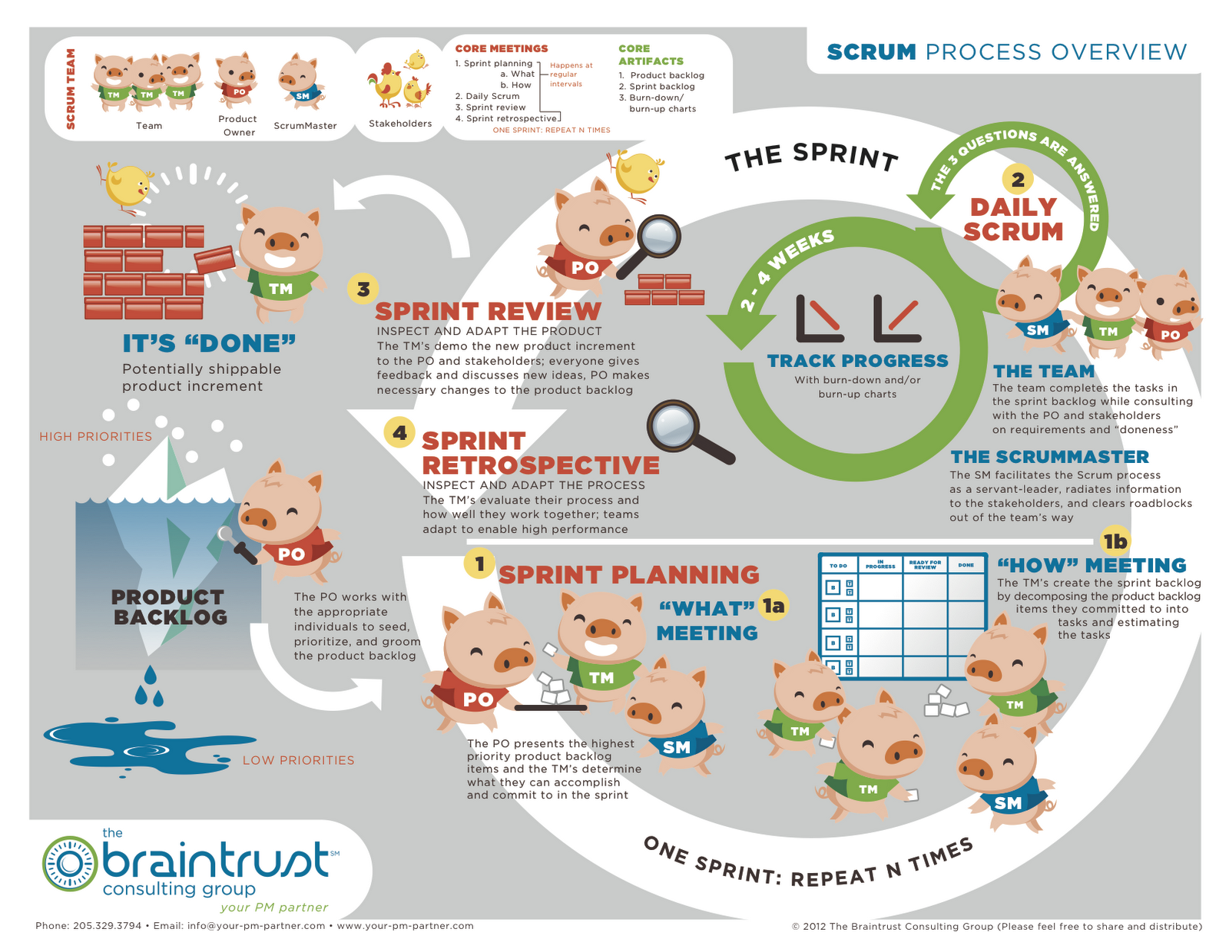
Scrum overview

Slide 16
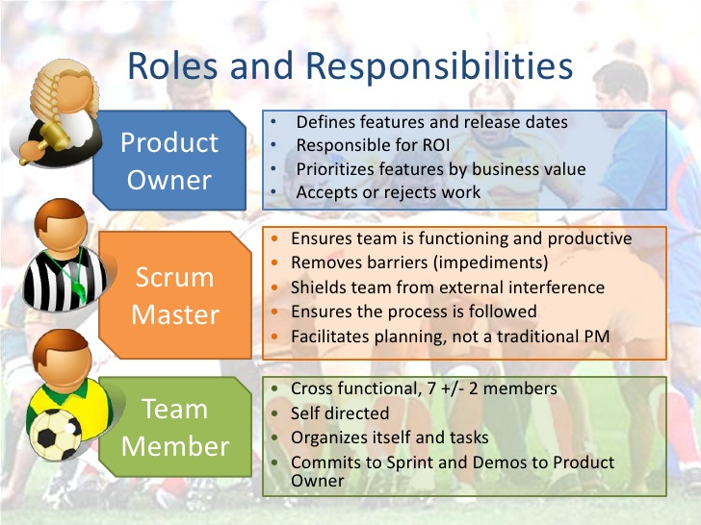
Scrum role

Slide 17
Scrum
For more detail, please refer document Scrum training_20160713.pptx which is in the same folder with this guideline.

